Slide 1

Department of ECE
Analog electronic Circuit Design
24ec2104
Topic:
Op-Amp characteristics

Slide 2



AIM OF THE SESSION
This session aims to discuss the DC and AC characteristics of Op-Amp and their interpretation for ideal and practical Op-Amps.
INSTRUCTIONAL OBJECTIVES
This Session is designed to:
  Define the electrical parameters/characteristics of the Op-Amp.
  Discuss the characteristics of ideal Op-Amp.
  Illustrate the significance of Practical Op-Amp.
LEARNING OUTCOMES
At the end of this session, you should be able to:
  Understand the DC and AC characteristics of the Op-Amp.
  Differentiate between ideal Op-Amp and Practical Op-Amp.

Slide 3
DC Characteristics of Op-Amp
The DC characteristics represent internal errors that occur as a result of mismatches between devices and components inside the op-amp. These errors are always present from the time the power is turned on (for example, before, during, and after any input signal is applied), and they determine how precisely the output matches the ideal op amp model. Thus, the precision of the op-amp is determined by the magnitude of the DC errors.
DC Characteristics of Op-Amp are:
1. Input Offset Voltage 2. Input Offset Current
3. Input Bias Current 4. Common Mode Rejection Ratio (CMRR)
5. Supply Voltage Rejection Ratio (SVRR) 6. Large Signal Voltage Gain

Slide 4
Input Offset Voltage
The input offset voltage (V_{io}) is defined as the voltage that must be applied between the two input terminals of the op-amp to obtain zero volts at the output. V_{io} is considered to be a DC error and is present from the moment that power is applied until it is turned off, with or without an input signal. It occurs during the biasing of the op-amp and its effect can only be reduced, not eliminated.
V_{dc1} and V_{dc2} are the DC voltages and R_{s} is the source resistance.
V_{io}= V_{dc1} - V_{dc2}
The smaller the value of V_{io}, the better the input terminals are matched.

Slide 5
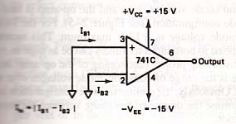
Input Offset Current
The input offset current (I_{io}) is defined as the algebraic difference between the currents into the inverting and non-inverting terminals.
I_{io} = | I_{B1} – I_{B2} |
where I_{B1} is the current into the non-inverting input and I_{B2} is the current into the inverting input .
As the matching between two input terminals is improved,
the I_{io} value decreases further.

Slide 6
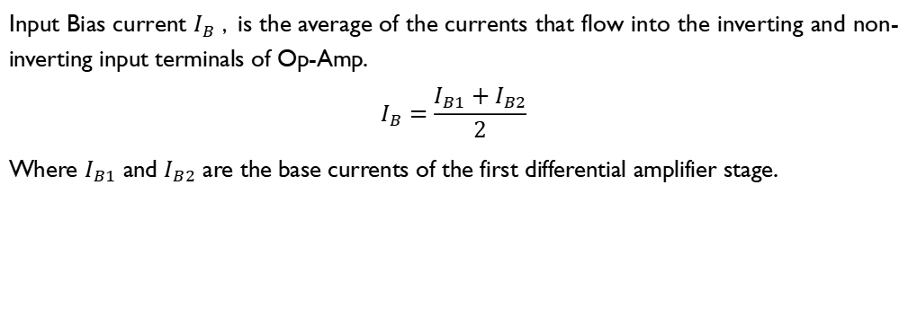
Input Bias Current
Input Bias current $I_{B}$ , is the average of the currents that flow into the inverting and non-inverting input terminals of Op-Amp.
$$I_{B}=\frac{I_{B1}+I_{B2}}{2}$$
Where $I_{B1}$ and $I_{B2}$ are the base currents of the first differential amplifier stage.

Slide 7
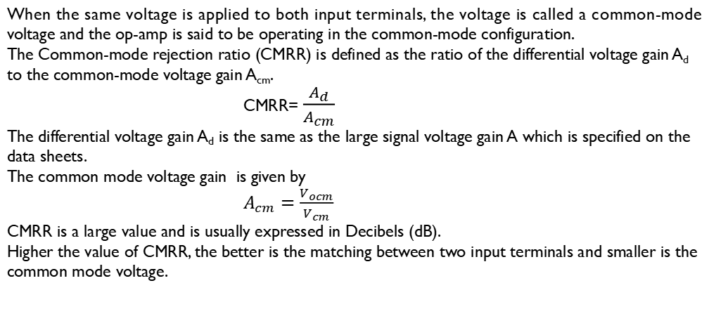
Common Mode Rejection Ratio (CMRR)
When the same voltage is applied to both input terminals, the voltage is called a common-mode voltage and the op-amp is said to be operating in the common-mode configuration.
The Common-mode rejection ratio (CMRR) is defined as the ratio of the differential voltage gain A_{d} to the common-mode voltage gain A_{cm}.
CMRR= $\frac{A_{d}}{A_{cm}}$
The differential voltage gain A_{d} is the same as the large signal voltage gain A which is specified on the data sheets.
The common mode voltage gain is given by
$A_{cm}=\frac{V_{ocm}}{V_{cm}}$
CMRR is a large value and is usually expressed in Decibels (dB).
Higher the value of CMRR, the better is the matching between two input terminals and smaller is the common mode voltage.

Slide 8
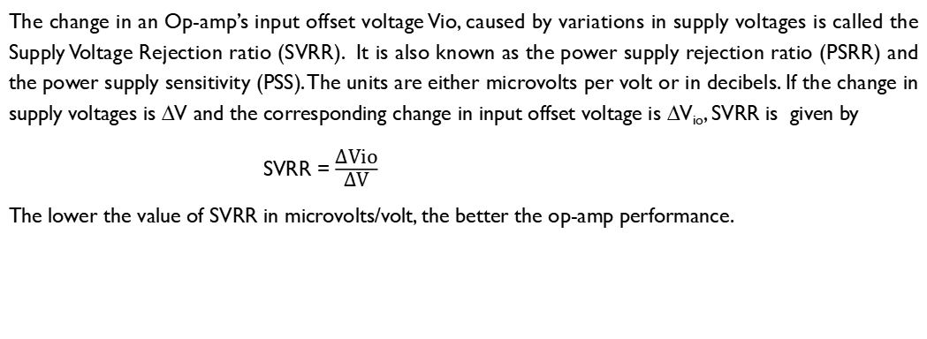
Supply Voltage Rejection Ratio (SVRR)
The change in an Op-amp’s input offset voltage Vio, caused by variations in supply voltages is called the Supply Voltage Rejection ratio (SVRR). It is also known as the power supply rejection ratio (PSRR) and the power supply sensitivity (PSS). The units are either microvolts per volt or in decibels. If the change in supply voltages is ∆V and the corresponding change in input offset voltage is ∆V_{io}, SVRR is given by
SVRR = $\frac{\text{∆}\text{Vio}}{\text{∆}\text{V}}$
The lower the value of SVRR in microvolts/volt, the better the op-amp performance.

Slide 9

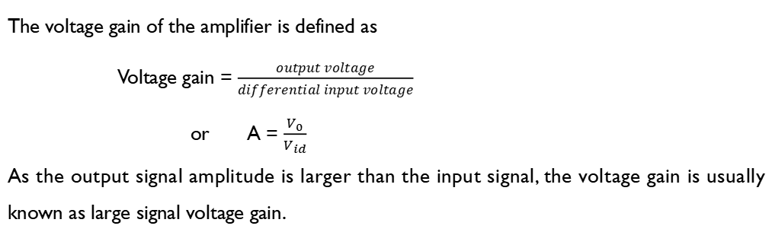
Large Signal Voltage Gain
The voltage gain of the amplifier is defined as
Voltage gain = $\frac{output voltage}{differential input voltage}$
or A = $\frac{V_{0}}{V_{id}}$
As the output signal amplitude is larger than the input signal, the voltage gain is usually known as large signal voltage gain.

Slide 10
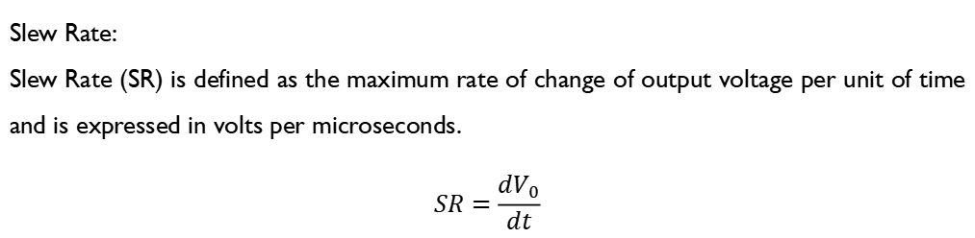
AC Characteristics
Slew Rate:
Slew Rate (SR) is defined as the maximum rate of change of output voltage per unit of time and is expressed in volts per microseconds.
$$SR=\frac{dV_{0}}{dt}$$
V/µS
max
Slew rate indicates how rapidly the output of an op-amp can change in response to changes in the input frequency. The SR changes with a change in voltage gain and is normally specified at unity gain.

Slide 11
Ideal Op-Amp
An ideal Op-Amp would exhibit the following characteristics
1. Infinite voltage gain A
2. Infinite input resistance R_{i} so that almost any signal source can drive it and there is no loading of the preceding stage.
3. Zero output resistance R_{o} so that the output can drive an infinite number of other devices.
4. Zero output voltage when input voltage is zero.
5. Infinite bandwidth so that any frequency signal from 0 to ∞ Hz can be amplified without attenuation.
6. Infinite common-mode rejection ratio so that the output common-mode noise voltage is zero.
7. Infinite slew rate so that output voltage changes occur simultaneously with input voltage changes.

Slide 12
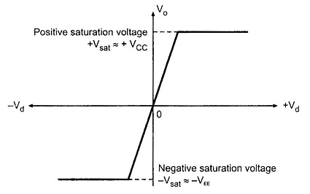
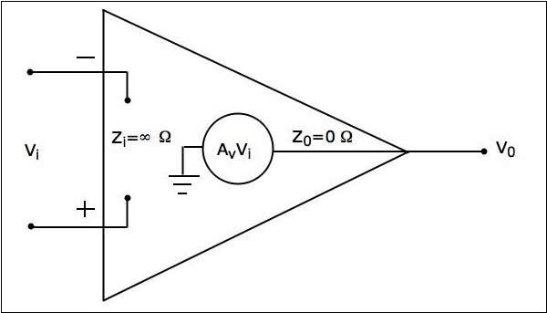
Ideal Op-Amp
Ideal voltage transfer curve
Equivalent Circuit

Slide 13
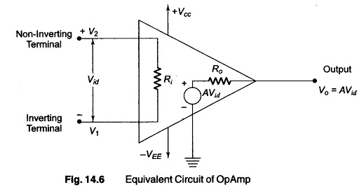
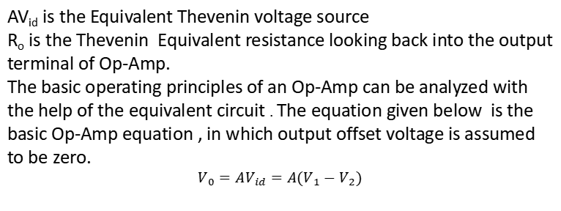
Practical Op-Amp
AV_{id} is the Equivalent Thevenin voltage source
R_{o} is the Thevenin Equivalent resistance looking back into the output terminal of Op-Amp.
The basic operating principles of an Op-Amp can be analyzed with the help of the equivalent circuit . The equation given below is the basic Op-Amp equation , in which output offset voltage is assumed to be zero.
$$V_{0}=AV_{id}=A(V_{1}−V_{2})$$
where
A = large signal voltage gain , V_{id} = differential input voltage
V₁ = voltage at Inverting terminal with respect to ground.
V₂ = voltage at non-inverting terminal with respect to ground.

Slide 14
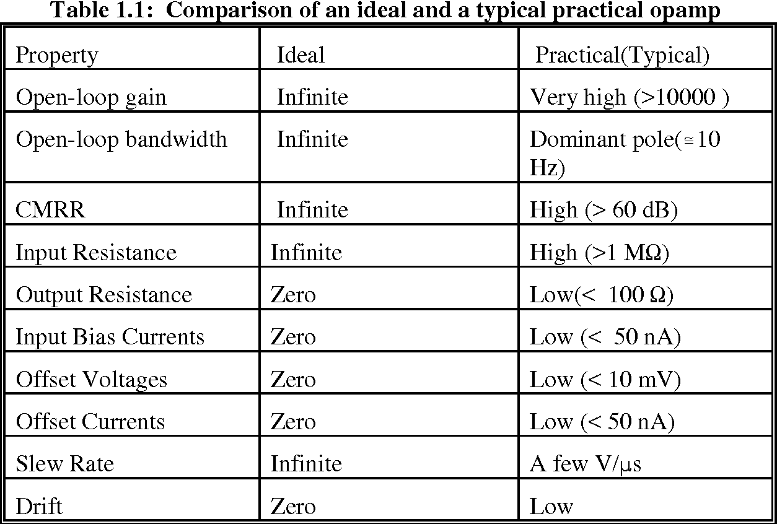
Comparison of Ideal and Practical Op-Amp

Slide 15
SELF-ASSESSMENT QUESTIONS
CMRR for an Op-Amp should be
As large as possible
Close to Unity
Zero
As small as possible
In an Op-Amp, the input impedance is _____ and the output impedance is ________.
Low; Low
Low; High
High; Low
High; High

Slide 16
SELF-ASSESSMENT QUESTIONS
3. In order for an output to swing above and below a zero reference, the Op-Amp circuit requires
A resistive feedback network
+VCC and - VEE
Zero Offset
Wide bandwidth
4. For an Ideal Op-Amp, which of the following is correct?
Infinite input impedance and infinite open loop gain
Zero input impedance and infinite open loop gain
Zero input impedance and zero open loop gain
Infinite input impedance and zero open loop gain

Slide 17
ANSWERS
a
c
b
a

Slide 18
TERMINAL QUESTIONS
List the parameters that should be considered for ac and dc applications.
What are the characteristics of an ideal Op-Amp?
For a given op-amp, CMRR = 10⁵ and differential gain Ad = 10⁵. Determine the common-mode gain A_{cm} of the op-amp.
The output voltage of a certain op-amp circuit changes by 20 Vin 4 µs. What is its slew rate?

Slide 19
REFERENCES FOR FURTHER LEARNING OF THE SESSION
Reference Books:
1. Op-Amps and Linear Integrated Circuit; 4th Ed., Gayakwad, Ramakant A.
Sites and Web links:
1https://www.allaboutcircuits.com/textbook/semiconductors/chpt-8/op-amp-practical-considerations/

Slide 20
THANK YOU
Team – AECD

